Slide 1
SORTING
Unit 2.4

Slide 2
Introduction
Sorting refers to arranging a set of data in some logical order
For ex. A telephone directory can be considered as a list where each record has three fields - name, address and phone number.
Being unique, phone number can work as a key to locate any record in the list.

Slide 3
Introduction
Sorting is among the most basic problems in algorithm design.
We are given a sequence of items, each associated with a given key value. And the problem is to rearrange the items so that they are in an increasing(or decreasing) order by key.
The methods of sorting can be divided into two categories:
  Internal Sorting
  External Sorting

Slide 4
Internal Sorting
  If all the data that is to be sorted can be adjusted at a time in main memory, then internal sorting methods are used
External Sorting
  When the data to be sorted can’t be accommodated in the memory at the same time and some has to be kept in auxiliary memory, then external sorting methods are used.
NOTE: We will only consider internal sorting

Slide 5
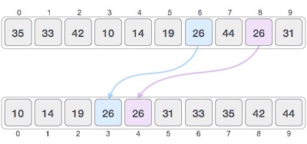
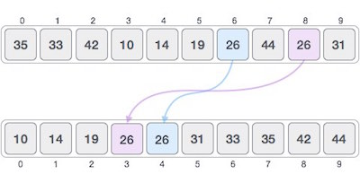
Stable and Not Stable Sorting
If a sorting algorithm, after sorting the contents, does not change the sequence of similar content in which they appear, it is called stable sorting.
If a sorting algorithm, after sorting the contents, changes the sequence of similar content in which they appear, it is called unstable sorting.

Slide 6
Efficiency of Sorting Algorithm
The complexity of a sorting algorithm measures the running time of a function in which n number of items are to be sorted.
The choice of sorting method depends on efficiency considerations for different problems.
Tree most important of these considerations are:
  The length of time spent by programmer in coding a particular sorting program
  Amount of machine time necessary for running the program
  The amount of memory necessary for running the program

Slide 7
Efficiency of Sorting Algorithm
Various sorting methods are analyzed in the cases like – best case, worst case or average case.
Most of the sort methods we consider have requirements that range from 0(nlogn) to 0(n²).
A sort should not be selected only because its sorting time is 0(nlogn); the relation of the file size n and the other factors affecting the actual sorting time must be considered

Slide 8
Efficiency of Sorting Algorithm
Determining the time requirement of sorting technique is to actually run the program and measure its efficiency.
Once a particular sorting technique is selected the need is to make the program as efficient as possible.
Any improvement in sorting time significantly affect the overall efficiency and saves a great deal of computer time.

Slide 9
Efficiency of Sorting Algorithm
Space constraints are usually less important than time considerations.
The reason for this can be, as for most sorting programs, the amount of space needed is closer to 0(n) than to 0(n²)
The second reason is that, if more space is required, it can almost always be found in auxiliary storage.

Slide 10
Things to remember
An ideal sort is an in-place sort where the algorithm uses no additional array storage, and hence it is possible to sort very large lists without the need to allocate additional working storage.
A sorting algorithm is said to be stable if two objects with equal keys appear in the same order in sorted output as they appear in the input unsorted array.
Some sorting algorithms are stable by nature like Insertion sort, Merge Sort, Bubble Sort, etc. And some sorting algorithms are not, like Heap Sort, Quick Sort, etc.

Slide 11
Things to remember
Sorting can be performed in many ways.
Over a time several methods (or algorithms) are being developed to sort data(s).
  Bubble sort, Selection sort, Quick sort, Merge sort, Insertion sort are the few sorting techniques discussed in this chapter.
It is very difficult to select a sorting algorithm over another. And there is no sorting algorithm better than all others in all circumstances.

Slide 12
BUBBLE SORT
In bubble sort, each element is compared with its adjacent element.
We begin with the 0th element and compare it with the 1st element.
If it is found to be greater than the 1st element, then they are interchanged.
In this way all the elements are compared (excluding last) with their next element and are interchanged if required
On completing the first iteration, largest element gets placed at the last position. Similarly in second iteration second largest element gets placed at the second last position and so on.

Slide 13











Slide 14
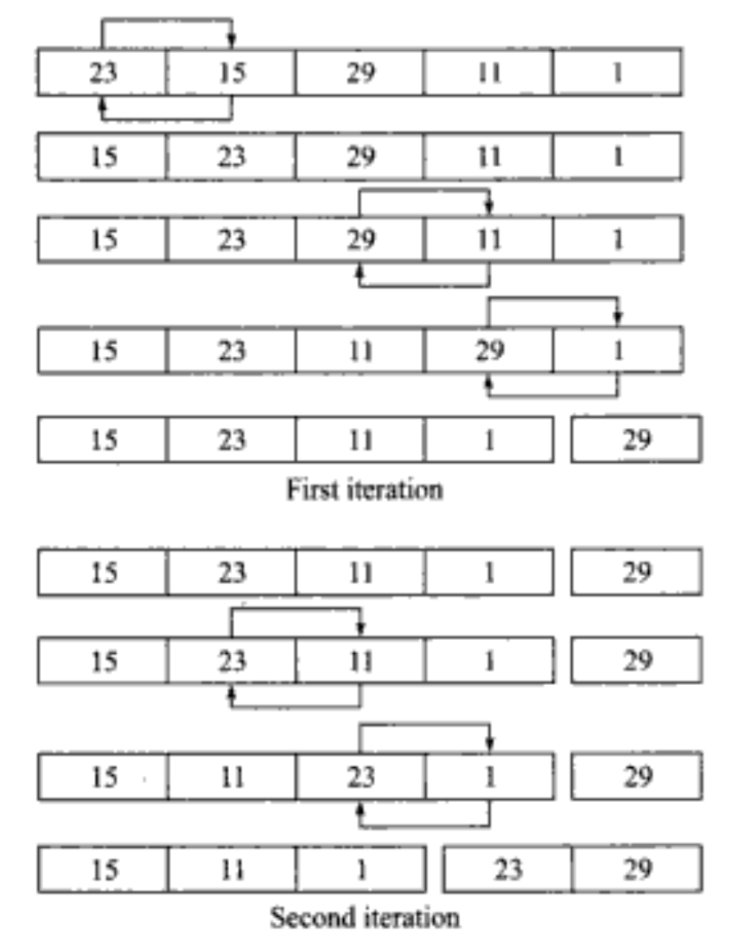
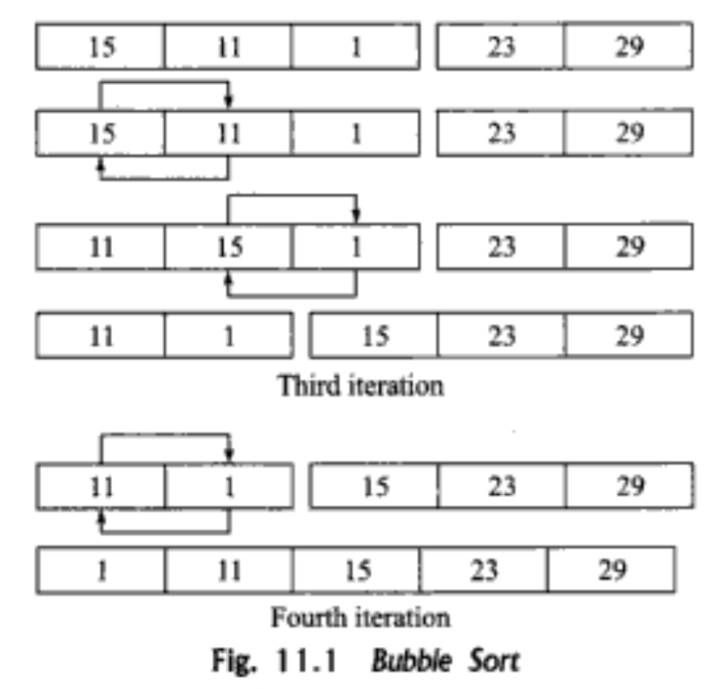

Slide 15
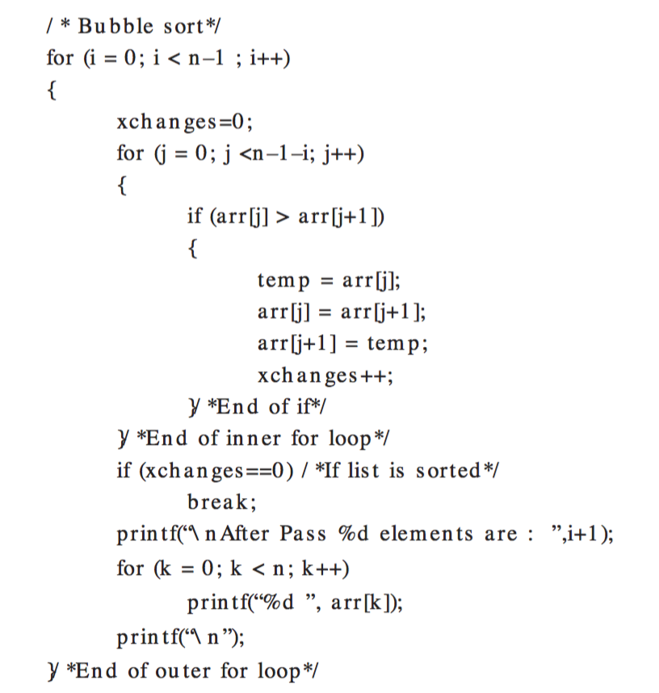
Algorithm

Slide 16
TIME COMPLEXITY
The time complexity for bubble sort is calculated in terms of the number of comparisons f(n) (or of number of loops)
Here two loops(outer loop and inner loop) iterates(or repeated) the comparison.
The inner loop is iterated one less than the number of elements in the list (i.e., n-1 times) and is reiterated upon every iteration of the outer loop
f (n) = (n – 1) + (n – 2) + ...... + 2 + 1
= n(n – 1) = O(n2).

Slide 17
TIME COMPLEXITY
Best Case
  sorting a sorted array by bubble sort algorithm
  In best case outer loop will terminate after one iteration, i.e it involves performing one pass which requires n-1 comparison
f (n) = O(n²)
Worst Case
  Suppose an array [5,4,3,2,1], we need to move first element to end of an array
  n-1 times the swapping procedure is to be called
  f (n) = O(n²)
Average Case
  Difficult to analyse than the other cases
  Random inputs, so in general
  f (n) = O(n²)
Space Complexity
  O(n)

Slide 18
SELECTION SORT
Find the least( or greatest) value in the array, swap it into the leftmost(or rightmost) component, and then forget the leftmost component, Do this repeatedly.
Let a[n] be a linear array of n elements. The selection sort works as follows:
Pass 1: Find the location loc of the smallest element in the list of n elements a[0], a[1], a[2], a[3], .........,a[n-1] and then interchange a[loc] and a[0].
Pass 2: Find the location loc of the smallest element int the sub-list of n-1 elements a[1], a[2], a[3], .........,a[n-1] and then interchange a[loc] and a[1] such that a[0], a[1] are sorted.
Then we will get the sorted list
a[0]<=a[2]<=a[3]…...<=a[n-1]

Slide 19
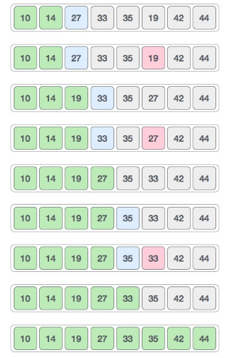

Slide 20
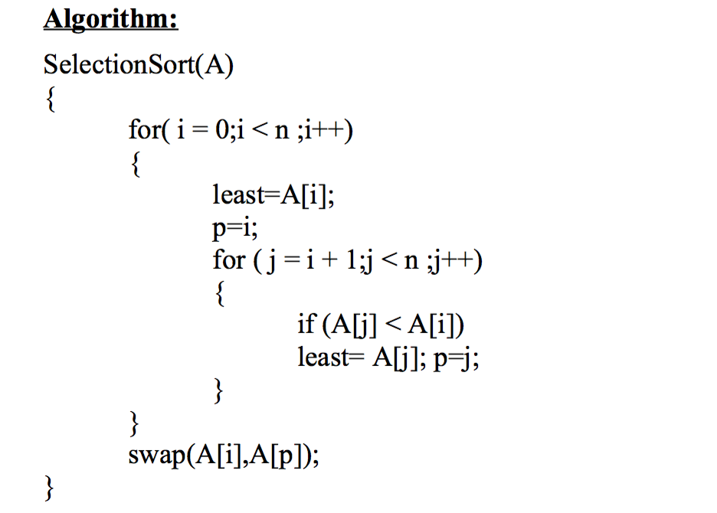

Slide 21
Time Complexity
Inner loop executes (n-1) times when i=0, (n-2) times when i=1 and so on:
Time complexity = (n-1) + (n-2) + (n-3) + …....... +2+1
= O(n²)
Space Complexity
  Since no extra space beside n variables is needed for sorting so
O(n)

Slide 22
Insertion Sort
Like sorting a hand of playing cards start with an empty hand and the cards facing down the table.
Pick one card at a time from the table, and insert it into the correct position in the left hand.
Compare it with each of the cards already in the hand, from right to left
The cards held in the left hand are sorted.

Slide 23
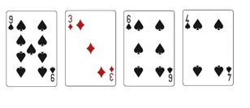





Slide 25
Insertion Sort
Suppose an array a[n] with n elements. The insertion sort works as follows:
Pass 1: a[0] by itself is trivially sorted.
Pass 2: a[1] is inserted either before or after a[0] so that a[0], a[1] is sorted.
Pass 3: a[2] is inserted into its proper place in a[0],a[1] that is before a[0], between a[0] and a[1], or after a[1] so that a[0],a[1],a[2] is sorted.
pass N: a[n-1] is inserted into its proper place in a[0],a[1],a[2],........,a[n-2] so that a[0],a[1],a[2],............,a[n-1] is sorted with n elements.

Slide 26
7 | 2 | 4 | 5 | 1 | 3
2 | 7 | 4 | 5 | 1 | 3
2 | 4 | 7 | 5 | 1 | 3
2 | 4 | 5 | 7 | 1 | 3
1 | 2 | 4 | 5 | 7 | 3
1 | 2 | 3 | 4 | 5 | 7

Slide 27
Algorithm
7 | 2 | 4 | 1 | 5 | 3
InsertionSort(){ for (i=1;i<n;i++){ value=C[ i ]; hole= i ; while(hole>0 && C[hole-1]>value){ C[hole]=C[hole-1]; hole=hole-1; } C[hole]=value; } }
1st Pass
7 | 7 | 4 | 1 | 5 | 3
2 | 7 | 4 | 1 | 5 | 3
i | value | hole
1 | 2 | 1
1 | 2 | 0

Slide 28
Time Complexity
Best Case:
  If the array is all but sorted then
  Inner Loop wont execute so only some constant time the statements will run
  So Time complexity= O(n)
Worst Case:
  Array element in reverse sorted order
  Time complexity=O(n²)
Space Complexity
  Since no extra space beside n variables is needed for sorting so
  Space Complexity = O(n)

Slide 29
Divide and conquer algorithms
The sorting algorithms we’ve seen so far have worst-case running times of O(n²)
When the size of the input array is large, these algorithms can take a long time to run.
Now we will discuss two sorting algorithms whose running times are better
  Merge Sort
  Quick Sort

Slide 30
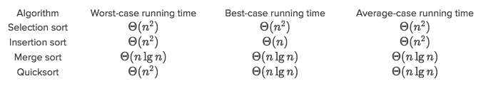
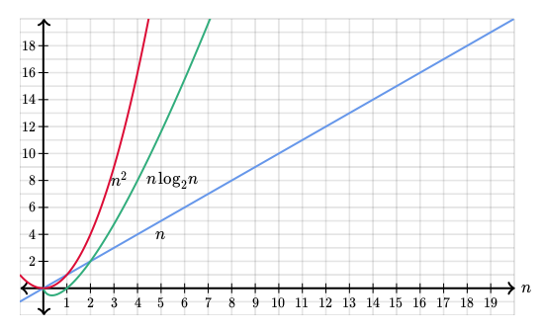

Slide 31
Divide-and-conquer
Divide-and-conquer, breaks a problem into sub problems that are similar to the original problem, recursively solves the sub problems, and finally combines the solutions to the sub problems to solve the original problem.
Think of a divide-and-conquer algorithm as having three parts:
  Divide the problem into a number of sub-problems that are smaller instances of the same problem.
  Conquer the sub-problems by solving them recursively. If they are small enough, solve the sub-problems as base cases.
  Combine the solutions to the sub-problems into the solution for the original problem.

Slide 32
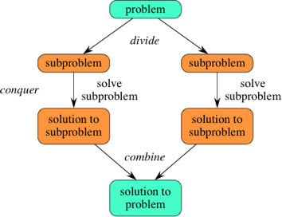
Divide-and-conquer

Slide 33
Merge Sort
Merge sort is a sorting technique based on divide and conquer technique.
Merge sort first divides the array into equal halves and then combines them in a sorted manner.
With worst-case time complexity being Ο(n log n), it is one of the most respected algorithms.

Slide 34
Merge Sort
Because we're using divide-and-conquer to sort, we need to decide what our sub problems are going to be.
Full Problem: Sort an entire Array
Sub Problem: Sort a sub array
Lets assume array[p..r] denotes this subarray of array.
For an array of n elements, we say the original problem is to sort array[0..n-1]

Slide 35
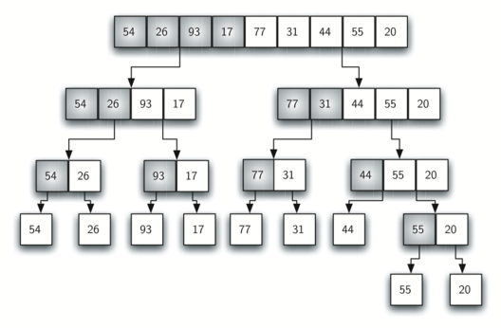
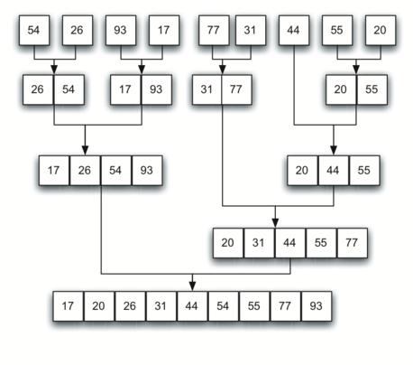

Slide 36
Merge Sort
Here’s how merge sort uses divide and conquer
  Divide by finding the number q of the position midway between p and r. Do this step the same way we found the midpoint in binary search: add p and r, divide by 2, and round down.
  Conquer by recursively sorting the subarrays in each of the two sub problems created by the divide step. That is, recursively sort the subarray array[p..q] and recursively sort the subarray array[q+1..r].
  Combine by merging the two sorted subarrays back into the single sorted subarray array[p..r].

Slide 37
Merge Sort
Let’s start with array holding [14,7,3,12,9,11,6,2]
We can say that array[0..7] where p=0 and r=7
In the divide step we compute q=3
The conquer step has us sort the two subarrays
  array[0..3] = [14,7,3,12]
  array[4..7]= [9,11,6,2]
  When we comeback from the conquer step, each of the two subarrays is sorted i.e.
  array[0..3] = [3,7,12,14]
  array[4..7]= [2,6,9,11]
Finally, the combine step merges the two sorted subarrays in first half and the second half, producing the final sorted array [2,3, 6,7,9, 11, 12,14]

Slide 38
How did the subarray array[0..3] become sorted?
It has more than two element so it’s not a base case.
So with p=0 and r=3, compute q=1, recursively sort array[0..1] and array[2..3], resulting in array[0..3] containing [7,14,3,12] and merge the fist half with the second half, producing [3,7,12,14]
How did the subarray array[0..1] become sorted?
With p=0 and r=1, compute q=0, recursively sort array[0..0] ([14]) and array[1..1] ([7]), resulting in array[0..1] still containing [14, 7], and merge the first half with the second half, producing [7, 14].

Slide 39
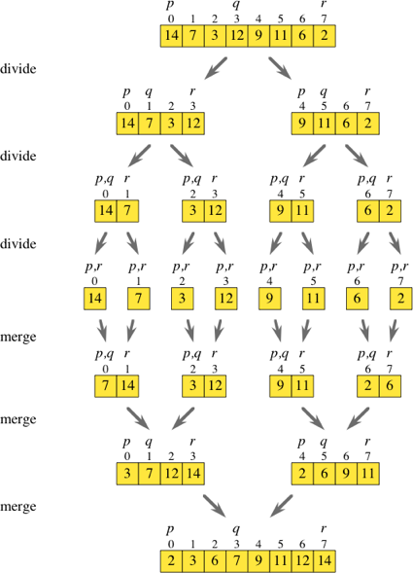

Slide 40
Analysis of merge Sort
We can view merge sort as creating a tree of calls, where each level of recursion is a level in the tree.
Since number of elements is divided in half each time, the tree is balanced binary tree.
The height of such a tree tend to be log n

Slide 41
Analysis of merge Sort
Divide and conquer
Recursive
Stable
Not In-place
0(n) space complexity
0(nlogn) time complexity

Slide 42
Recursive function calls and finally merge | Merge function merges the whole block of array
void MergeSort(int *A,int n) { int mid,i, *L, *R; if(n < 2) return; mid = n/2; L = (int*)malloc(mid*sizeof(int)); R = (int*)malloc((n- mid)*sizeof(int)); for(i = 0;i<mid;i++) L[i] = A[i]; // creating left subarray for(i = mid;i<n;i++) R[i-mid] = A[i]; // creating right subarray MergeSort(L,mid); MergeSort(R,n-mid); Merge(A,L,mid,R,n-mid); free(L); free(R); } | void Merge(int *A,int *L,int leftCount,int *R,int rightCount) { int i,j,k; i = 0; j = 0; k =0; while(i<leftCount && j< rightCount) { if(L[i] < R[j]) A[k++] = L[i++]; else A[k++] = R[j++]; } while(i < leftCount) A[k++] = L[i++]; while(j < rightCount) A[k++] = R[j++]; }

Slide 43
Analysis of merge Sort
The time to merge sort n numbers is equal to the time to do two recursive merge sorts of size n/2 plus the time to merge, which is linear.
We can express the number of operations involved using the following recurrence relations
T(1)=1
T(n) =2T(n/2)+n
Going further down using the same logic
T(n/2)=2T(n/2)+n/2
Continuing in this manner, we can write
T(n)=nT(1)+nlogn
=n+nlogn
T(n)=0(nlogn)

Slide 44
Analysis of merge Sort
Although merge sort’s running time is very attractive it is not preferred for sorting data in main memory.
Main problem arises when the it uses linear extra memory as we need to copy the original array into two arrays of half the size and the additional work spent on copying to the temporary array and back
This might considerably slow down the time to sort
However merge sort can work very well with linked list as it doesn’t require additional space. Since we only need to change pointer links rather than shifting the element.

Slide 45
Quick Sort
Quick sort is one of the most popular sorting techniques.
As the name suggests the quick sort is the fastest known sorting algorithm in practice.
It has the best average time performance.
It works by partitioning the array to be sorted and each partition in turn sorted recursively. Hence also called partition exchange sort.

Slide 46
Quick Sort
In partition one of the array elements is choses as a pivot element
Choose an element pivot=a[n-1]. Suppose that elements of an array a are partitioned so that pivot is placed into position I and the following condition hold:
  Each elements in position 0 through i-1 is less than or equal to pivot
  Each of the elements in position i+1 through n-1 is greater than or equal to key
The pivot remains at the i^{th} position when the array is completely sorted. Continuously repeating this process will eventually sort an array.

Slide 47
current
pivot
wall
6 | 5 | 1 | 3 | 8 | 4 | 7 | 9 | 2
current
pivot
wall
6 | 5 | 1 | 3 | 8 | 4 | 7 | 9 | 2
current
pivot
wall
6 | 5 | 1 | 3 | 8 | 4 | 7 | 9 | 2
current
pivot
wall
1 | 5 | 6 | 3 | 8 | 4 | 7 | 9 | 2
current
pivot
wall
1 | 2 | 6 | 3 | 8 | 4 | 7 | 9 | 5

Slide 48
Algorithm
Choosing a pivot
  To partition the list we first choose a pivot element
Partitioning
  Then we partition the elements so that all those with values less than pivot are placed on the left side and the higher vale on the right
  Check if the current element is less than the pivot.
    If lesser replace it with the current element and move the wall up one position
    else move the pivot element to current element and vice versa
Recur
  Repeat the same partitioning step unless all elements are sorted

Slide 49
Analysis of Quick Sort
Best case
  The best case analysis assumes that the pivot is always in the middle
  To simplify the math, we assume that the two sublists are each exactly half the size of the original T(N)=T(N/2)+T(N/2)….+1 leads to T(N)=O(nlogn)
Average case
  T(N)=O(nlogn)
Worst case
  When we pick minimum or maximum as pivot then we have to go through each and every element so
  T(N) = O(n²)

Slide 50
Heap
A heap is defined as an almost complete binary tree of nodes n such that value of each node is less than or equal to the value of the father OR greater than or equal to the value of the father.
  Descending heap is an almost complete binary tree in which the value of each node is smaller or equal to the value of its father
  Ascending heap is an almost complete binary tree in which the value of each node is greater or equal to the value of its father

Slide 51
Heap
Heap is a special case of balanced binary tree data structure where root-node key is compared with its children and arranged accordingly.
If α has child node β then −
  Key(α) >= key(β)
As the value of the parent is greater than that of child, this property generates MAX heap. Based on this criteria a heap can be of two types
  Min - Heap
  Max - Heap

Slide 52
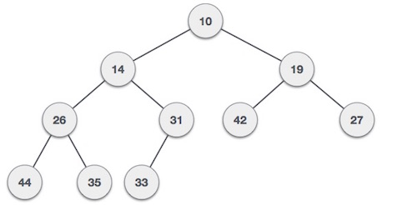
Heap
Min-Heap
  Where the value of the root node is less than or equal to either of its children
  For input 35 33 42 10 14 19 27 44 26 31

Slide 53
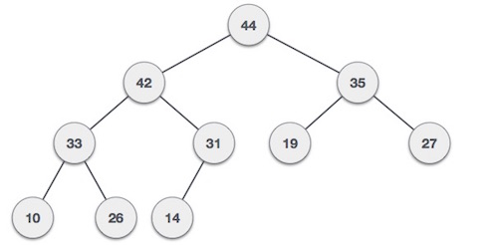
Heap
Max-Heap −
  where the value of root node is greater than or equal to either of its children.
  For input 35 33 42 10 14 19 27 44 26 31

Slide 54
Max Heap Construction Algorithm
Step 1 − Create a new node at the end of heap.
Step 2 − Assign new value to the node.
Step 3 − Compare the value of this child node with its parent.
Step 4 − If value of parent is less than child, then swap them.
Step 5 − Repeat step 3 & 4 until Heap property holds.

Slide 55
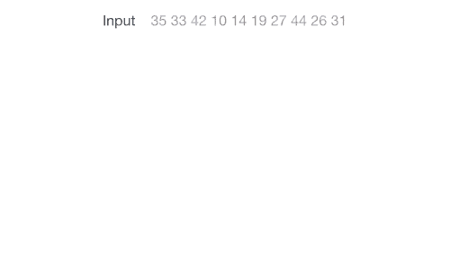

Slide 56
Max Heap Deletion Algorithm
Step 1 − Remove root node.
Step 2 − Move the last element of last level to root.
Step 3 − Compare the value of this child node with its parent.
Step 4 − If value of parent is less than child, then swap them.
Step 5 − Repeat step 3 & 4 until Heap property holds.

Slide 57
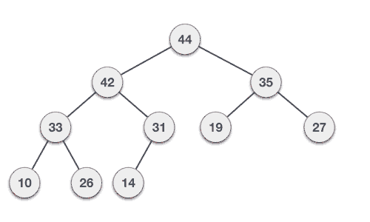

Slide 58
Analysis of Heap Sort
The worse case complexity of the heap sort is O(nlogn), therefore, Heap sort is superior to quick sort in the worst case
Heap sort is not very efficient for small array because of the overhead of initial heap creation and computation.
The space requirement for the hap sort is only one additional record to hold the temporary value.

Slide 59
Radix Sort
The idea behind radix sort is slightly more complex than that of bucket sort.
Algorithm:
  Take the least significant digit of each element in the unsorted array
  Perform a stable sort based on that key
  Repeat the process sequentially with each more significant digit

Slide 60
Radix Sort
For example suppose we want to sort the list
849 , 770 , 67 , 347 , 201 , 618 , 66 , 495 , 13 , 45
Sorting by least significant digit(i.e. ones digit)
770 , 201 , 13 , 495 , 45 , 66 , 67 , 347 , 618 , 849
Stability is maintained. Now sort by more significant tens digit,
201 , 13 , 618 , 45 , 347 , 849 , 66 , 67 , 770 , 495
We now consider the hundreds digit to be zero
13 , 45 , 66 , 67 , 201 , 347 , 495 , 618 , 770 , 849

Slide 61
Reference
https://www.khanacademy.org/computing/computer-science/algorithms/insertion-sort/a/insertion-sort
http://www.tutorialspoint.com/data_structures_algorithms/sorting_algorithms.htm
http://bigocheatsheet.com/
http://stackoverflow.com/questions/5222730/why-is-merge-sort-preferred-over-quick-sort-for-sorting-linked-lists

